Slide 1
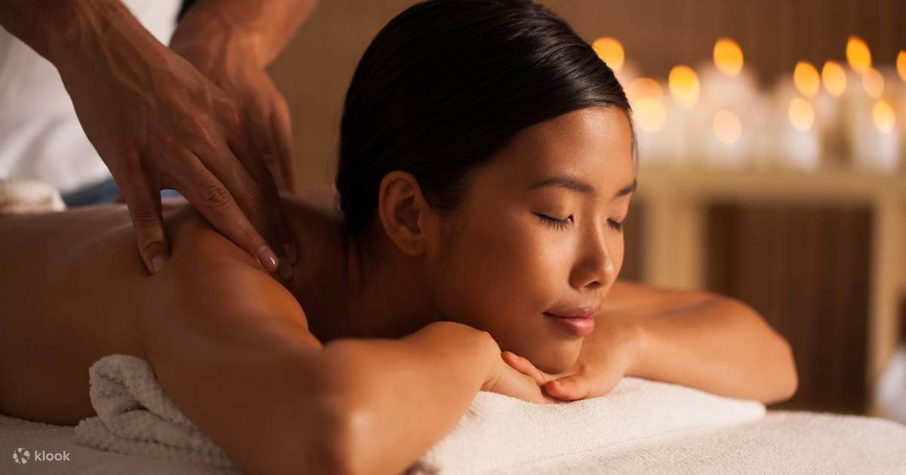

A Capstone Project presented by
Charmaine David
Jonas Ricafort
Norman Guevarra
Beloved John Villaflor

Slide 2
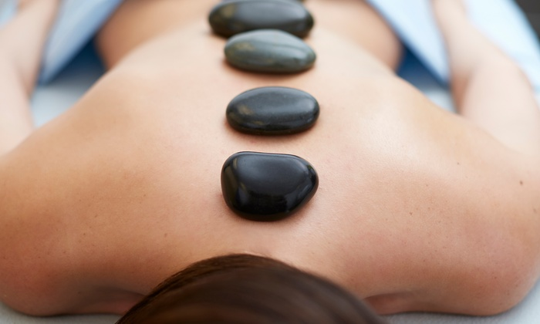
CONCEPT of the PROJECT
Background of the business
Inspired by the convenience and flexibility of the Uber/Grab ride-hailing service, we came up with the idea of creating a spa service that worked in a similar way.
With the help of technology and a network of skilled and experienced spa professionals, we launched the platform, allowing customers to book a spa treatment on-demand.
Notes:
Our goal was to make spa services more accessible, affordable, and convenient for people who lead busy lives. We believe that everyone deserves to be pampered and feel their best, and their platform was designed to make that possible.
They also made sure to vet all their service providers, ensuring that customers could trust that they were getting the highest quality service.

Slide 3
CONCEPT of the PROJECT
Background of the business
Today, the platform is known as the go-to destination for people who want to relax, rejuvenate, and feel their best, without the hassle of traditional spa bookings.
With this innovative approach and commitment to customer satisfaction, SPAce aims to transform the way people think about spa services.
Notes:
Our goal was to make spa services more accessible, affordable, and convenient for people who lead busy lives. We believe that everyone deserves to be pampered and feel their best, and their platform was designed to make that possible.
They also made sure to vet all their service providers, ensuring that customers could trust that they were getting the highest quality service.

Slide 4
CONCEPT of the PROJECT
WHAT WE DO
Bridge the gap between the clients and the specialists via this online gateway to connect them.
The clients to be pampered
And
The specialists to provide their services
Whenever, Wherever
Notes:
Our goal was to make spa services more accessible, affordable, and convenient for people who lead busy lives. We believe that everyone deserves to be pampered and feel their best, and their platform was designed to make that possible.
They also made sure to vet all their service providers, ensuring that customers could trust that they were getting the highest quality service.

Slide 5
CONCEPT of the PROJECT
HOW IT WORKS
Users would download the spa website's app or access the website through their web browser.
Users would create an account and input their payment information.
Users would then be able to browse a variety of spa services, including massages, facials, and other treatments.
Users would select the service they want, and the app would display the available service providers in their area.
Users would select their preferred service provider based on factors such as their ratings and availability.
Notes:
Our goal was to make spa services more accessible, affordable, and convenient for people who lead busy lives. We believe that everyone deserves to be pampered and feel their best, and their platform was designed to make that possible.
They also made sure to vet all their service providers, ensuring that customers could trust that they were getting the highest quality service.

Slide 6
CONCEPT of the PROJECT
HOW IT WORKS
Users would then be able to book their appointment, including the date, time, and location where they would like the service to be performed.
The service provider would then receive the booking request and confirm the appointment.
The service provider would arrive at the specified location to provide the spa service.
After the service is completed, the user would pay through the app, and they would have the option to rate and provide feedback on the service provider.
Overall, a spa website that works like Uber or Grab would provide users with a convenient and flexible way to access spa services on-demand, without the need for advanced booking or scheduling. This would make it easier for people to relax, de-stress, and take care of their bodies in a way that fits their busy schedules.
Notes:
Our goal was to make spa services more accessible, affordable, and convenient for people who lead busy lives. We believe that everyone deserves to be pampered and feel their best, and their platform was designed to make that possible.
They also made sure to vet all their service providers, ensuring that customers could trust that they were getting the highest quality service.

Slide 7
CONCEPT of the PROJECT
WHY WE CHOSE THIS CONCEPT
To provide an online space where the stressed can find a way to get pampered with various spa related services.
The site works like an uber/grab and it aims to provide users with a convenient and flexible way to access spa services on demand.
With it being available online, this would make it easier for people to relax, distress and take care of their bodies in a way that fits their busy schedules.
It also helps the specialists get bookings based on their availability without being confined to straight shifts on the usual tenure set-up.
Notes:
Our goal was to make spa services more accessible, affordable, and convenient for people who lead busy lives. We believe that everyone deserves to be pampered and feel their best, and their platform was designed to make that possible.
They also made sure to vet all their service providers, ensuring that customers could trust that they were getting the highest quality service.

Slide 8
CONCEPT of the PROJECT
Rationale for the color scheme and font choice
Gold – luxury
Spa services are often views as something luxurious
Dark blue green – harmony and prosperity, strong nature-related imagery; blue tint gives off trustworthiness and wisdom
SPAce strives to be a trustworthy site
Notes:
Our goal was to make spa services more accessible, affordable, and convenient for people who lead busy lives. We believe that everyone deserves to be pampered and feel their best, and their platform was designed to make that possible.
They also made sure to vet all their service providers, ensuring that customers could trust that they were getting the highest quality service.

Slide 9
WIREFRAME
WHY WE CHOSE THIS CONCEPT
To provide an online space where the stressed can find a way to get pampered with various spa related services.
The site works like an uber/grab and it aims to provide users with a convenient and flexible way to access spa services on demand.
With it being available online, this would make it easier for people to relax, distress and take care of their bodies in a way that fits their busy schedules.
It also helps the specialists get bookings based on their availability without being confined to straight shifts on the usual tenure set-up.
Notes:
Our goal was to make spa services more accessible, affordable, and convenient for people who lead busy lives. We believe that everyone deserves to be pampered and feel their best, and their platform was designed to make that possible.
They also made sure to vet all their service providers, ensuring that customers could trust that they were getting the highest quality service.

Slide 10
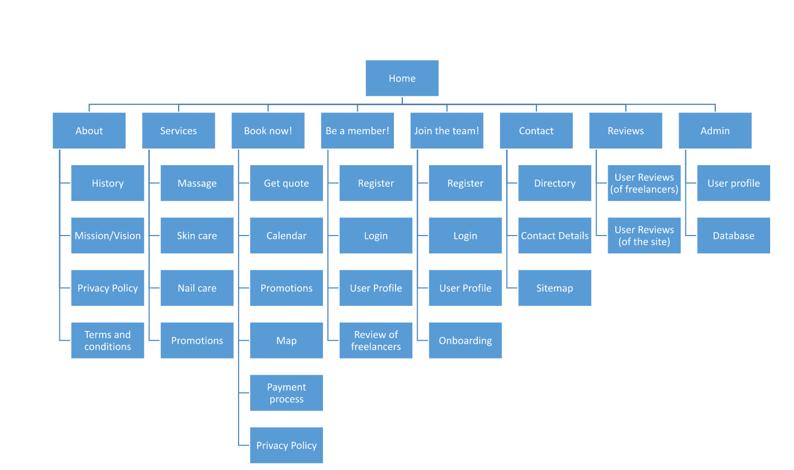
SITEMAP
Notes:
Our goal was to make spa services more accessible, affordable, and convenient for people who lead busy lives. We believe that everyone deserves to be pampered and feel their best, and their platform was designed to make that possible.
They also made sure to vet all their service providers, ensuring that customers could trust that they were getting the highest quality service.

Slide 11
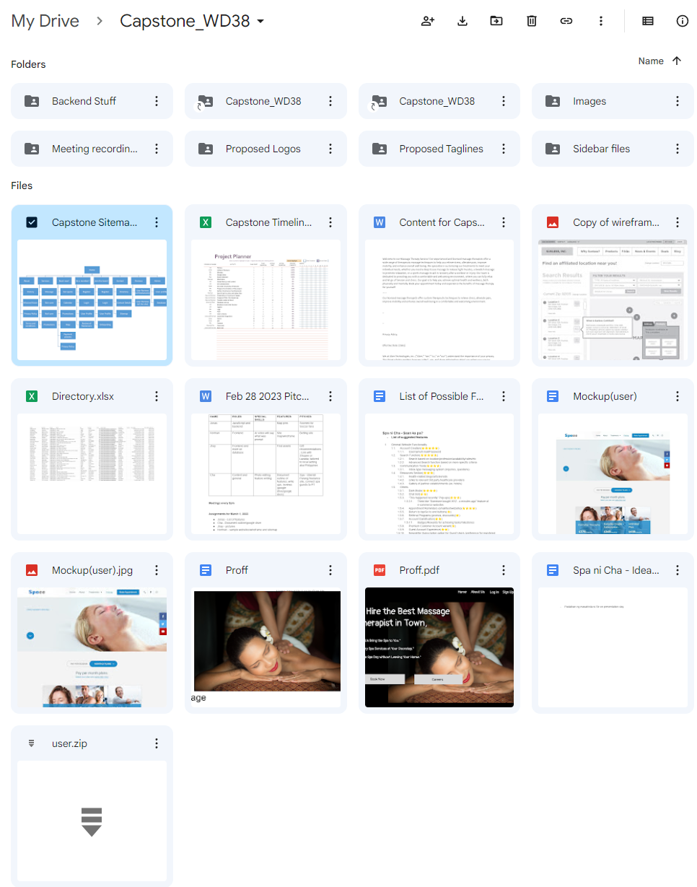
RESOURCES USED FOR PLANNING
STORAGE OF VARIOUS FILES USED FOR PLANNING
Notes:
Our goal was to make spa services more accessible, affordable, and convenient for people who lead busy lives. We believe that everyone deserves to be pampered and feel their best, and their platform was designed to make that possible.
They also made sure to vet all their service providers, ensuring that customers could trust that they were getting the highest quality service.

Slide 12
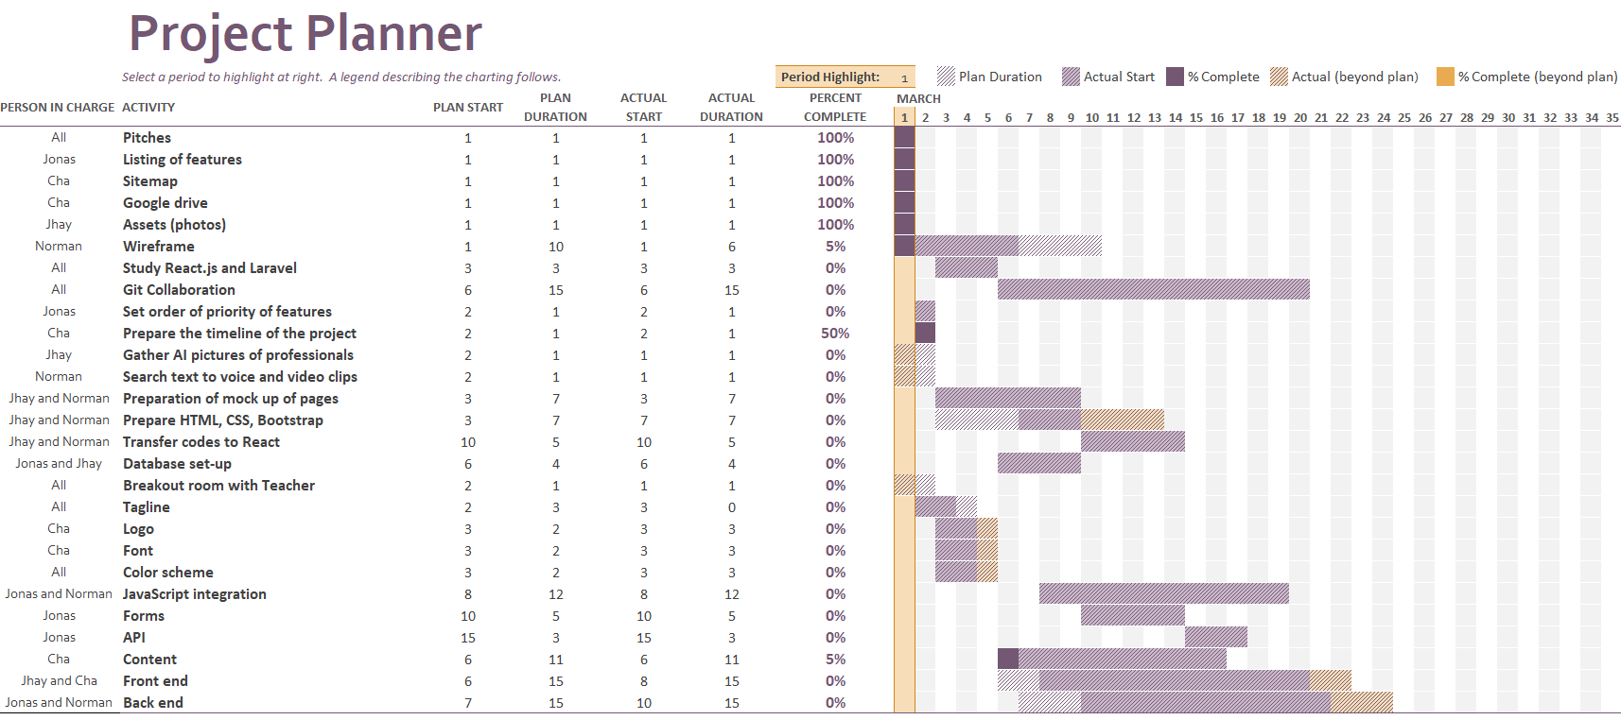
RESOURCES USED FOR PLANNING
Timeline
Notes:
Our goal was to make spa services more accessible, affordable, and convenient for people who lead busy lives. We believe that everyone deserves to be pampered and feel their best, and their platform was designed to make that possible.
They also made sure to vet all their service providers, ensuring that customers could trust that they were getting the highest quality service.

Slide 13
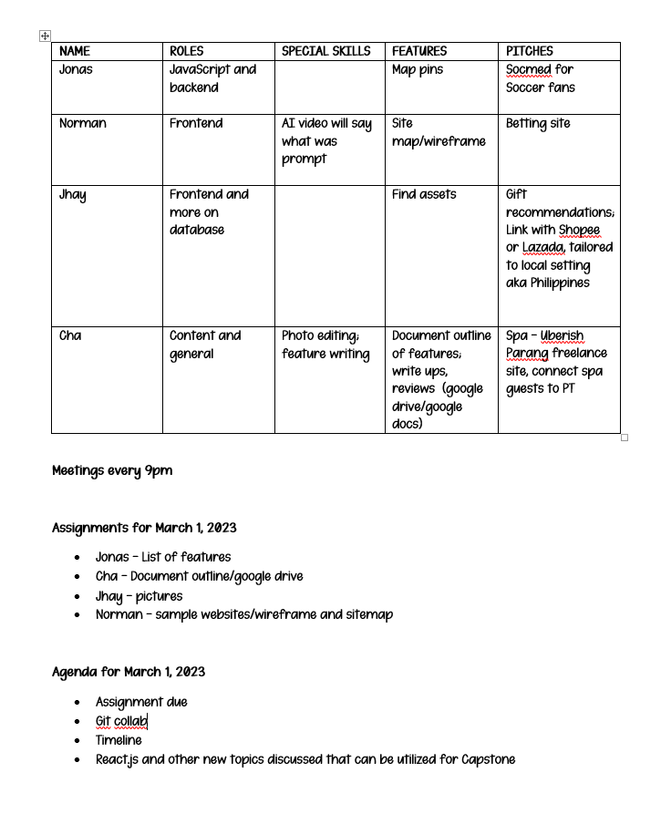
RESOURCES USED FOR PLANNING
Sample
MINUTES OF MEETINGS
Notes:
Our goal was to make spa services more accessible, affordable, and convenient for people who lead busy lives. We believe that everyone deserves to be pampered and feel their best, and their platform was designed to make that possible.
They also made sure to vet all their service providers, ensuring that customers could trust that they were getting the highest quality service.

Slide 14
TECHNOLOGIES USED
HTML
CSS
JavaScript)
jQuery
Bootstrap
Laravel
PHP
SQL
Git Bash
Git Hub
Git Hub Pages
Adobe Photoshop
Moqup
W3schools
DaFont.com
Google Drive
MS Office
Codepen.io -
for some components
Notes:
Our goal was to make spa services more accessible, affordable, and convenient for people who lead busy lives. We believe that everyone deserves to be pampered and feel their best, and their platform was designed to make that possible.
They also made sure to vet all their service providers, ensuring that customers could trust that they were getting the highest quality service.

Slide 15

CONCEPT of the PROJECT SPAce
Reduce and Eliminate Expenses
Decide on a Location
Set Goals and Create a Plan

Slide 16
CONCEPT of the PROJECT SPAce
Reduce and Eliminate Expenses
Decide on a Location
Set Goals and Create a Plan

Slide 17
Common Travel Seasons

Slide 18



Make a Plan
Set a destination and/or travel theme
1
Set travel dates, mode of travel, and find accommodations
2
Find local attractions, food venues, and activities
3

Slide 19

Thank you
space@space.com

